Slide 1
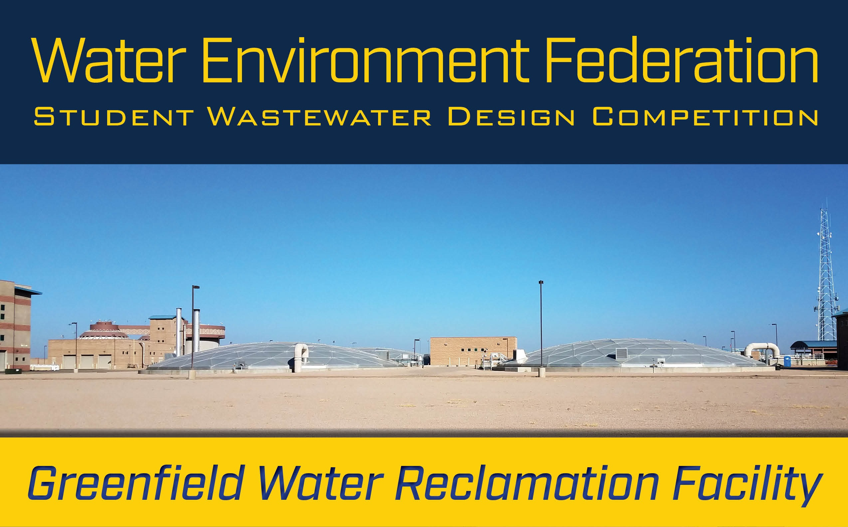

By: Nicholas Babcock, Jed Ward, Maxwell Ward, Ryan Winter
Northern Arizona University
2018
UGRAD Presentation 04/27/

Slide 2

COMPETITION INFORMATION
Competing at the 91st annual AZ Waters conference on May 2nd to May 4th
Winners of the AZ Waters competition will go on to compete at the WEFTEC conference in New Orleans
The competition includes a redesign of a wastewater treatment plant in Arizona
Notes:
max

Slide 3
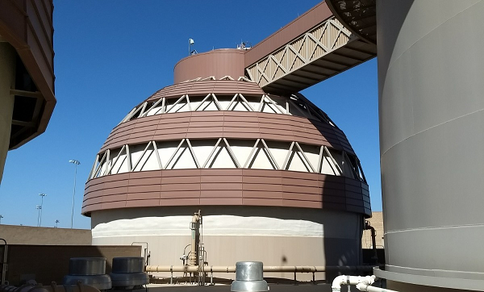
COMPETITION PROMPT
Greenfield Water Reclamation Facility (GWRF) is located in Gilbert, Arizona and serves the Town of Gilbert, City of Mesa, and Town of Queen Creek
Table 1: Capacity and Quality Parameters
Existing | Expansion
16 Million Gallons per Day (MGD) Annual Average Daily Flow (AADF) with additional 8MGD solids from Southeast Water Reclamation Plant | Increase by 14 MGD AADF for liquid and solids
Produces Class A+ reclaimed water and Class B biosolids | Maintain class A+ reclaimed water and Class B biosolids
Figure 1: Egg-shaped digester photograph taken by Ryan Winter
Notes:
ryan

Slide 4
COMPETITION OBJECTIVES
Analyze historic wastewater characteristics and existing treatment processes
Upgrade the plant to a capacity of 30 MGD (with a peak flow of 60MGD)
Implementation/construction plan for expansion
Figure 2: Secondary clarifiers and solids handling building
photograph by Jed Ward
Notes:
ryan

Slide 5
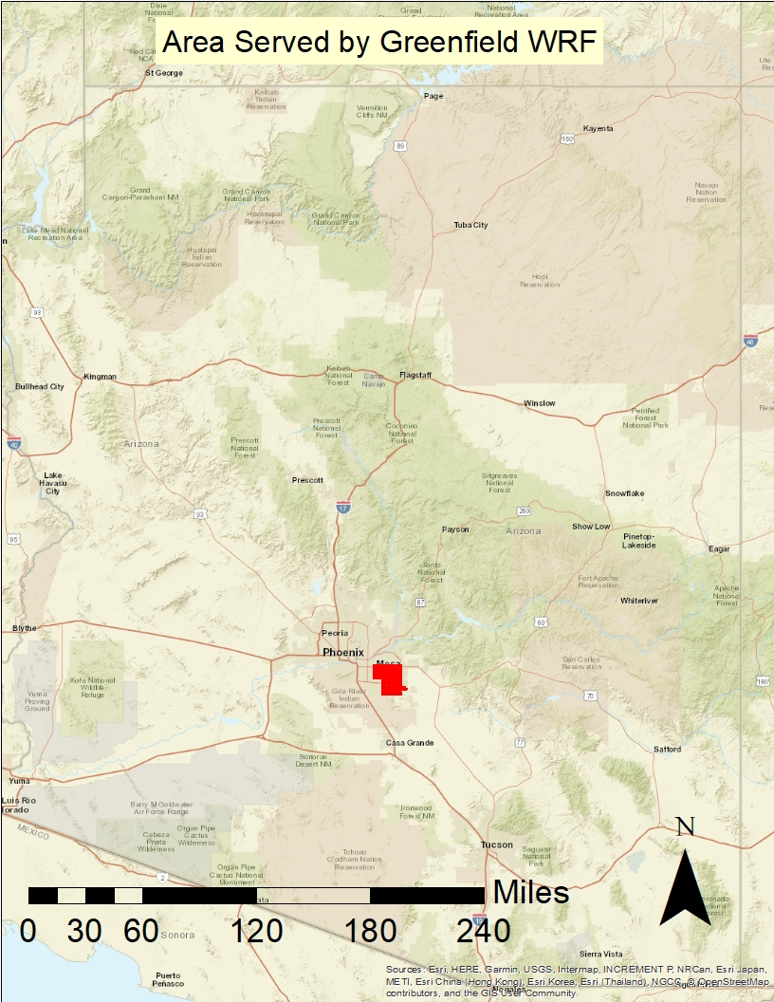
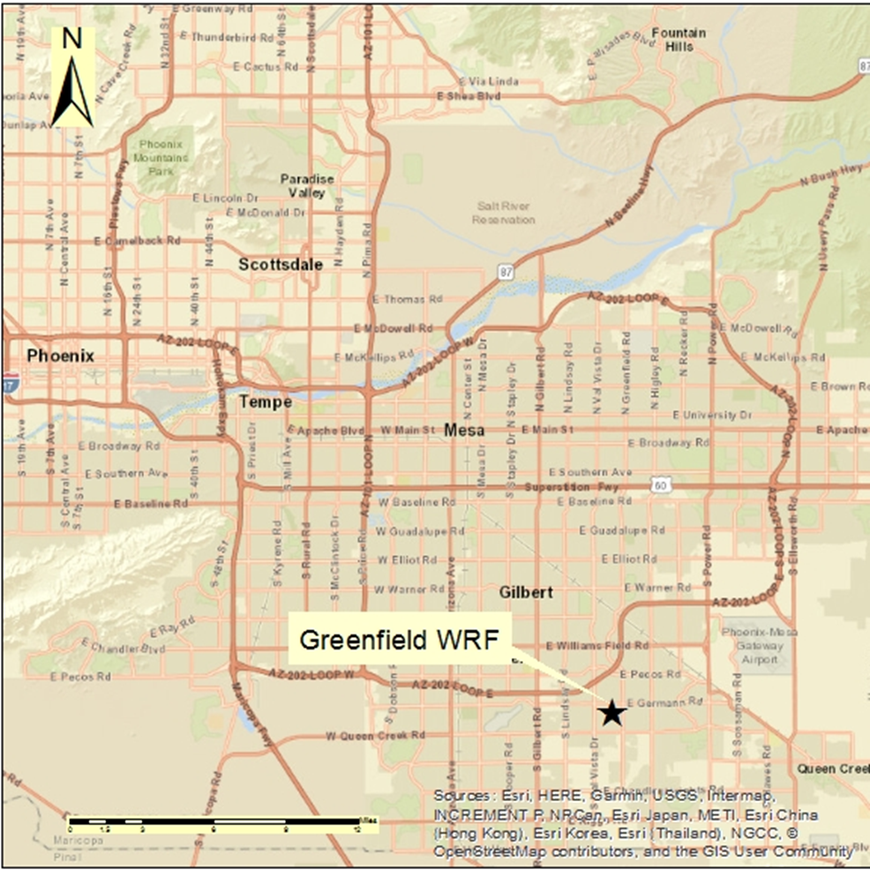
Figure 4: City view of the location of Greenfield WRF
Figure 3: State view of area
served by Greenfield WRF
Notes:
ryan

Slide 6
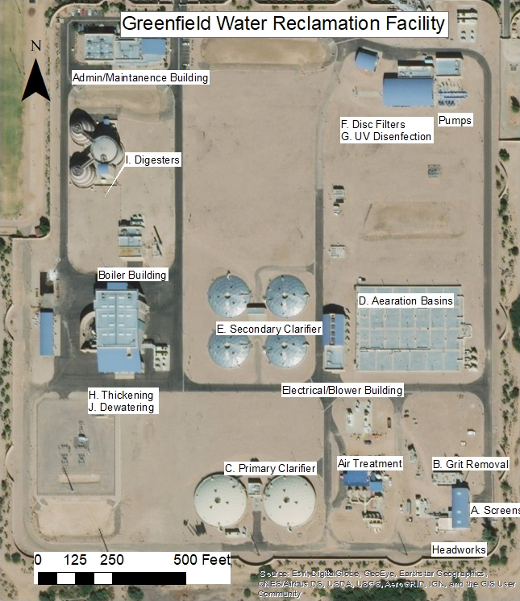
Four Duperon Flex Rake Influent Screens
Two WesTech Induced Vortex Grit Removal Systems
Two Circular Primary Sedimentation Basins
Two MLE Aeration Basins
Four Circular Secondary Clarifiers
Six Kruger Tertiary Filtration Units
Two UV Disinfection Channels with WEDECO Lamps
Two Westfalia Thickening Centrifuges
Two Egg-Shaped Digesters
Two Westfalia Dewatering Centrifuges
Two Blended Sludge Tanks
One Thickened Sludge Tank
One Digested Sludge Storage Tank
Two Dewatered Cake Storage Tanks
Figure 5: Greenfield WRF aerial photograph of existing layout labeled
Notes:
Ryan (ADD IN EXISTING TREATMENT PROCESS UNITS BULLET POINTS)

Slide 7
WASTEWATER CHARACTERISTICS
Influent wastewater characteristics from 2007-2018 provided by GWRF were analyzed to predict design values for the expansion
Table 2: Predicted Wastewater Characteristics
Flow (MGD) | TKN (mg/L) | TSS (mg/L) | COD (mg/L) | BOD (mg/L)
15 | 55.9 | 384.3 | 822.7 | 298.2
25 | 64.2 | 431.1 | 909.7 | 319.7
30 | 67.1 | 447.8 | 940.8 | 327.4
45 | 73.6 | 484.9 | 1009.8 | 344.6
60 | 78.3 | 511.2 | 1058.8 | 356.7
TKN-Total Kjeldahl Nitrogen
TSS-Total Suspended Solids
BOD-Biological Oxygen Demand
COD-Chemical Oxygen Demand
Notes:
jed

Slide 8
HYDRAULIC ANALYSIS
Microsoft Excel was used to create a model
The capacity of existing treatment units were input [1]
The new design flow of 60 MGD was used for calculations
Hydraulic Retention Time (HRT) for each unit was found
HRT value was compared to the critical HRT values found in design literature to determine if expansion was required [2]
Notes:
max

Slide 9
POTENTIAL EXPANSION
Table 3: GWRF Potential Expansion Units
EXPANSION REQUIRED | EXPANSION NOT REQUIRED
Liquids Stream
Grit Removal System | Influent Screening
Primary Sedimentation Basins
Aeration Basins
Secondary Clarifiers
Tertiary Filtration
Disinfection
Solids Stream
Sludge Thickening | Blended Sludge Storage Tanks
Sludge Digestion | Thickened Sludge Storage Tanks
Sludge Dewatering | Digested Sludge Storage Tanks
 | Dewatered Cake Storage
Notes:
max

Slide 10
DESIGN CRITERIA
Various alternatives that fit the threshold criteria of meeting the required capacity, fitting within the area of the plant, and being readily available were analyzed in decision matrices with five criteria
  Life cycle cost
  Feasibility/ Constructability
  Efficiency Improvements
  Social Impacts
  Operations and Maintenance (O&M)
Notes:
nick

Slide 11
OPPORTUNITIES FOR UNIT IMPROVEMENTS
Existing units at GWRF are considered to be the industry standard so adding redundant units was considered for each unit that required expansion
Alternatives that were considered were:
1. WesTech aerated grit chamber 2. Rectangular primary sedimentation basin 3. Huber primary drum screens 4. Rectangular secondary clarifiers 5. Dual media filters | 6. Chlorine disinfection 7. Gravity belt thickeners 8. Rotating drum thickeners 9. Cambi thermal hydrolysis 10. Belt press dewatering
Notes:
nick

Slide 12
ECONOMIC ANALYSIS
The economic analysis was created using vendors quotes, design reports, and manufacturers websites
A typical 30 years of life was used to create a present worth life cycle cost 2018 dollars for Phoenix, AZ
Used City Construction Index to make estimations more accurate for Phoenix
Used Consumer Cost Index to bring cost of values to present worth
Notes:
jed

Slide 13
ECONOMIC ANALYSIS
Table 4: Economic Analysis Matrix Criteria
Economic Analysis Rating Criteria
Score | Criteria
1 | Significant increase in redundant units life cycle cost (over 20% increase)
2 | Minor increase in redundant units life cycle cost (between 0% and 20% increase)
3 | Redundant units life cycle cost
4 | Minor decrease in redundant units life cycle cost (between 0% and 20% decrease)
5 | Significant decrease in redundant units life cycle cost (over 20% decrease)
Table 5: Economic Analysis Matrix Example
GRIT REMOVAL
Alternatives | Rating | Reason for Given Rating
Option 1: Add one redundant WesTech mechanically-induced vortex grit removal system | 3 | Adding a redundant WesTech mechanically-induced vortex grit removal system was rated at a three because it has a life cycle cost of approximately $1.37 million.
Option 2: Add one WesTech aerated grit chamber | 1 | Adding one WesTech aerated grit chamber was rated at a two because it has a life cycle cost of approximately $3.16 million.

Slide 14
FEASIBILITY ANALYSIS
This feasibility analysis is based upon the potential space savings of the alternatives, compatibility of the new unit with existing infrastructure, and compatibility with units for future expansion phases.
Table 6: Feasibility Analysis Matrix Criteria
Feasibility Analysis Rating Criteria
Score | Criteria
1 | Not feasible
2 | Feasible with minor modifications
3 | No modifications to existing
4 | Improves on existing features
5 | Improves on existing features and future expansion
Notes:
jed

Slide 15
FEASIBILITY ANALYSIS
Table 7: Feasibility Analysis Matrix Example
DISINFECTION
Alternatives | Rating | Reason for Given Rating
Option 1: Add two redundant UV channels with WEDECO lamps | 5 | Adding two redundant UV channels with WEDECO lamps was rated at a five because the additional units are easily compatible and would allow for simple future expansion.
Option 2: Replace with chlorine contact | 2 | Replacing the existing UV disinfection system with chlorine contact was rated at a two because this would require implementing chlorine contact basins and demolishing the existing UV system which would be difficult for further expansion.

Slide 16
EFFICIENCY IMPROVEMENTS ANALYSIS
This analysis is based upon various measurements of efficiency that are applicable to each unit and how they compare with the existing treatment efficiency.
Table 8: Efficiency Improvements Analysis Matrix Criteria
Efficiency Improvement Analysis Rating Criteria
Score | Criteria
1 | Major decrease in efficiency (less than 20% efficient)
2 | Minor decrease in efficiency (between 20% and 0% less efficient)
3 | No change to efficiency
4 | Minor increase in efficiency (between 0% and 20% more efficient)
5 | Major increase in efficiency (greater than 20% more efficient)
Notes:
max

Slide 17
EFFICIENCY IMPROVEMENTS ANALYSIS
Table 9: Efficiency Improvements Analysis Matrix Example
PRIMARY SEDIMENTATION BASIN
Alternatives | Rating | Reason for Given Rating
Option 1: Add one redundant primary sedimentation basin | 3 | Adding one redundant primary sedimentation basin was rated at a three because there would be no increase or decrease in efficiency.
Option 2: Add one rectangular sedimentation basin | 2 | Adding a rectangular sedimentation basin was rated at a two because while rectangular and circular configurations are in theory similar in efficiency, rectangular basins suffer from short circuiting which considerably reduces efficiency.
Option 3: Replace with Huber primary drum screens | 5 | Huber primary drum screens were rated at a five because they are more efficient in constituent removal, have a much lower HRT, and increases efficiency by 30-40% in the aeration basins.

Slide 18
SOCIAL IMPACTS ANALYSIS
This social impacts analysis was based on assumed impacts from increased costs and changes in public response to environmental impacts.
Table 10: Social Impact Matrix Criteria
Social Impacts Analysis Rating Criteria
Score | Criteria
1 | Major negative social impact
2 | Minor negative social impact
3 | No social impact
4 | Minor positive social impact
5 | Major positive social impact
Notes:
ryan

Slide 19
SOCIAL IMPACTS ANALYSIS
Table 11: Social Impact Matrix Example
EGG-SHAPED DIGESTERS
Alternatives | Rating | Reason for Given Rating
Option 1: Add two redundant anaerobic digesters | 3 | No social impact.
Option 2: Add Cambi Thermal Hydrolysis prior to digestion and one redundant digester | 4 | Adding thermal hydrolysis was rated at a four because it will produce Class A biosolids along with less residual leaving the plant and save room in landfills.

Slide 20
OPERATIONS AND MAINTENANCE ANALYSIS
This O&M analysis was based on the safety and satisfaction of the operators in GWRF.
Table 12: Operations and Maintenance Matrix Criteria
Operations and Maintenance Analysis Rating Criteria
Score | Criteria
1 | Major decrease in safety and operations and maintenance
2 | Minor decrease in safety and operations and maintenance
3 | Negligible impact to operations and maintenance
4 | Minor increase in safety and operations and maintenance
5 | Major increase in safety and operations and maintenance
Notes:
nick

Slide 21
OPERATIONS AND MAINTENANCE ANALYSIS
Table 13: Operations and Maintenance Matrix Example
DISINFECTION
Alternatives | Rating | Reason for Given Rating
Option 1: Add two redundant UV channels with WEDECO lamps | 3 | Adding two redundant UV channels with WEDECO lamps was rated at a three because there would be no increase or decrease in safety or O&M processes.
Option 2: Replace with chlorine contact | 1 | Replacing the existing UV disinfection system with chlorine contact was rated at a one because chlorine is a hazardous chemical and would require special considerations.

Slide 22
PROPOSED IMPROVEMENTS
Based on research and analysis of GWRF’s existing treatment processes and units that required expansion improvements were decided for the facility
The result of the analyses were input into decision matrices and were utilized to determine the best alternatives that should be implemented
Table 14: GWRF Proposed Expansion Units
Quantity | Units
1 | Redundant WesTech mechanically-induced vortex grit removal system
1 | Redundant primary sedimentation basin
2 | Redundant MLE aeration basins
3 | Redundant secondary clarifiers
6 | Redundant Kruger cloth-media disk filters
2 | Redundant UV channels with WEDECO lamps
2 | Redundant Westfalia centrifuges
1 | Redundant Anaerobic digester
1 | Cambi Thermal Hydrolysis prior to digestion
1 | Redundant Westfalia solid bowl dewatering centrifuge
Notes:
Nick

Slide 23
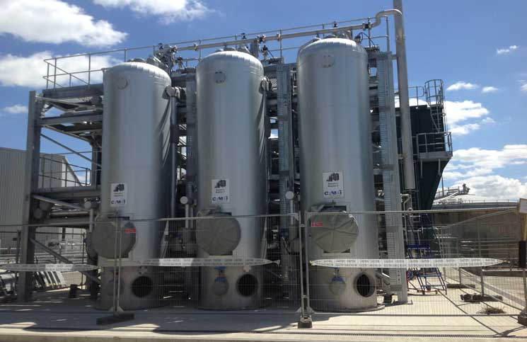
CAMBI THERMAL HYDROLYSIS
Heats sludge to break down larger organic molecules
Dissolves and disintegrates sludge prior to digestion
Maximizes biogas production and reduces sludge
Shortens HRT in digesters
Results in up to 40% more efficient dewatering [3]
Produces Class A biosolids [3]
Figure 6: Cambi THP Unit at Hampton Roads, VA
Notes:
Nick (ADD MORE)

Slide 24
EXPANSION COST
The life cycle cost of the expansion is approximately $152.46 Million.
This cost estimate excludes odor control, pumps, piping, monitoring equipment, rehabilitation of existing units, and other miscellaneous costs therefore the actual cost is likely to be 20-25% higher
Table 15: Final Expansion Cost
Expansion Units | Life Cycle Cost
One WesTech mechanically-induced vortex grit removal system | $1.37 Million
One redundant primary sedimentation basin | $4.19 Million
Two redundant MLE aeration basins | $45.68 Million
Three redundant secondary clarifiers | $11.36 Million
Six redundant Kruger cloth-media disk filters | $11.60 Million
Two redundant UV channels with WEDECO lamps | $27.94 Million
Two redundant Westfalia centrifuges | $4.53 Million
One redundant anaerobic digester | $12.28 Million
Cambi Thermal Hydrolysis prior to digestion | $27.01 Million
One redundant Westfalia solid bowl dewatering centrifuge | $6.50 Million
Total Cost of Project | $152.46 Million
Notes:
jed

Slide 25
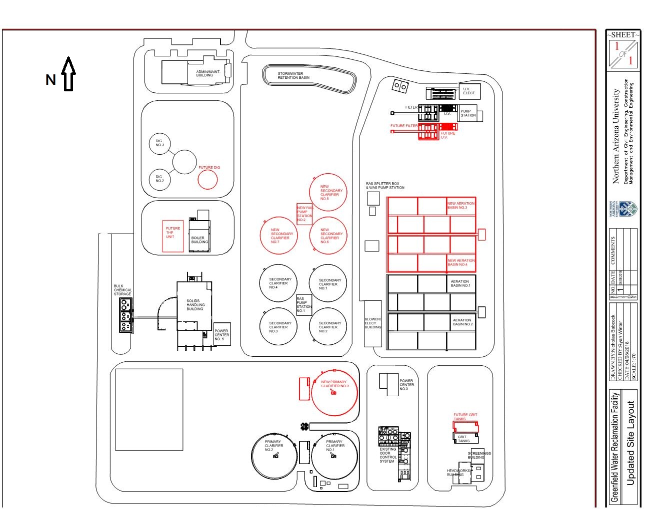
Figure 7: Updated Site Layout
Notes:
nick

Slide 26
IMPLEMENTATION AND CONSTRUCTION
Table 16: Expansion Implementation Schedule
Expansion Construction Schedule
Tasks | Duration | 2018 |  |  |  |  |  |  |  | 2019 |  |  |  |  |  |  |  |  |  |  |  | 2020 |  |  |  |  |  |  |  |  |  |  |  | 2021
 | (months) | M | J | J | A | S | O | N | D | J | F | M | A | M | J | J | A | S | O | N | D | J | F | M | A | M | J | J | A | S | O | N | D | J | F | M | A
Total | 36
Preliminary Work | 3
Earthwork | 6
Concrete | 9
Mechanical | 8
Piping/Pumping | 4
Demolition | 3
Site Finishing | 3
Testing/Training | 6
Completion | 6
Notes:
Nick
RecommendationsChlorine contact basins for future expansions
Using cogeneration by capturing biogas and using gas generators
Primary screens for future expansions to increase biogas production
Move toward net zero energy use
Direct potable reuse

Slide 27
SCHEDULE
Table 17: Schedule
Task Name | Start | Expected Finish | Actual Finish
Receive Prompt | 1/13/2018 | 1/13/2018 | 1/26/2018
Initial/Final Flow Diagram | 1/15/2018 | 1/22/2018 | 1/30/2018
Define Constraints and Criteria | 1/15/2018 | 2/11/2018 | 2/11/2018
Site Tour | 2/3/2018 | 2/3/2018 | 2/3/2018
Hydraulic Analysis | 1/29/2018 | 2/11/2018 | 3/5/2018
WW Analysis | 1/29/2018 | 2/11/2018 | 2/11/2018
Sizing Capacity Analysis | 2/4/2018 | 2/23/2018 | 3/12/2018
Expansion Feasibility Analysis | 2/7/2018 | 2/28/2018 | 2/28/2018
Primary Technology Selection/Implementation | 2/12/2018 | 2/28/2018 | 3/12/2018
Project Plan Due | 3/5/2018 | 3/5/2018 | 3/5/2018
Cost Estimations | 3/3/2018 | 4/6/2018 | 4/17/2018
Final Report | 4/16/2018 | 4/16/2018 | 4/16/2018
Final Presentation Prep | 4/16/2018 | 5/3/2018 | 5/3/2018
Final Presentation | 5/4/2018 | 5/4/2018 | 5/4/2018
Notes:
maxwell

Slide 28
STAFFING HOURS
Table 18: Proposed and Actual Staff Hours
# | TASK | Proposed Hours | Actual Hours
1 | Initial Flow Diagram | 6 | 8
2 | Define Constraints and Criteria | 13 | 15
3 | Site Tour | 50 | 48
4 | Hydraulic Analysis | 50 | 55
5 | WW Characteristics Analysis | 50 | 56
6 | Expansion Feasibility Analysis | 13 | 16
7 | Primary Technology Selection | 38 | 35
8 | Project Plant Due | 44 | 50
9 | Decision Matrices | 219 | 237
10 | Selection of Proposed Improvements | 31 | 20
11 | Implementation and Construction | 13 | 15
12 | Final Report | 63 | 75
13 | Final Presentation Prep | 13 | 25
14 | Final Presentation | 5 | 3
 | Total Hours | 605 | 658
Notes:
max

Slide 29
STAFFING HOURS
Table 19: Staffing Actual Hours
# | TASK | Project Manager | Senior Engineer | EIT | EIT | Total
1 | Initial Flow Diagram | 0 | 1 | 3 | 3 | 8
2 | Define Constraints and Criteria | 1 | 2 | 6 | 6 | 15
3 | Site Tour | 2 | 5 | 20 | 20 | 48
4 | Hydraulic Analysis | 3 | 6 | 23 | 23 | 55
5 | WW Characteristics Analysis | 3 | 6 | 24 | 24 | 56
6 | Expansion Feasibility Analysis | 1 | 2 | 7 | 7 | 16
7 | Primary Technology Selection | 2 | 4 | 15 | 15 | 35
8 | Project Plant Due | 3 | 5 | 21 | 21 | 50
9 | Decision Matrices | 12 | 25 | 100 | 100 | 237
10 | Selection of Proposed Improvements | 1 | 2 | 9 | 9 | 20
11 | Implementation and Construction | 1 | 2 | 6 | 6 | 15
12 | Final Report | 4 | 8 | 32 | 32 | 75
13 | Final Presentation Prep | 1 | 3 | 11 | 11 | 25
14 | Final Presentation | 0 | 0 | 1 | 1 | 3
 | Total Hours | 33 | 66 | 280 | 280 | 658
Notes:
max

Slide 30
PERSONNEL AND ADDITIONAL COSTS
Table 20: Cost for Personnel
Staff | Project Manger | Senior Engineer | EIT | EIT
Rate | $140 | $105 | $85 | $75
Hours | 33 | 66 | 263 | 263
Total | $4,606 | $6,909 | $22,372 | $19,740
Combined Total | $53,627
Table 21: Additional Costs
Other Expenses | Travel (mi) | Night Stay | Travel Meals | 3-D Printing/Poster
Unit | 400 | 1 | 24 | 1
Rate | $0.50 | $120 | $20 | $90
Total | $200 | $120 | $480 | $90
Sum Total | $890
Notes:
max

Slide 31
REFERENCES
[1] Carollo Engineers, "South Water Reclamation Plant Phase II Expansion," Mesa, 2003.
[2] M. &. Eddy, Wastewater Engineering Treatment and Reuse, Boston: McGraw Hill, 2003.
[3] Meneco, L. (2012). Cambi Thermal hydrolysis Sludge Treatment: Medium to Large-Scale Application. Environmentindex.com. Available at: http://www.environmentindex.com/en/article/cambi-thermal-hydrolysis-sludge-treatment-medium-to-large-scale-application-677.aspx Accessed 25 Apr. 2018.

